Slide 1
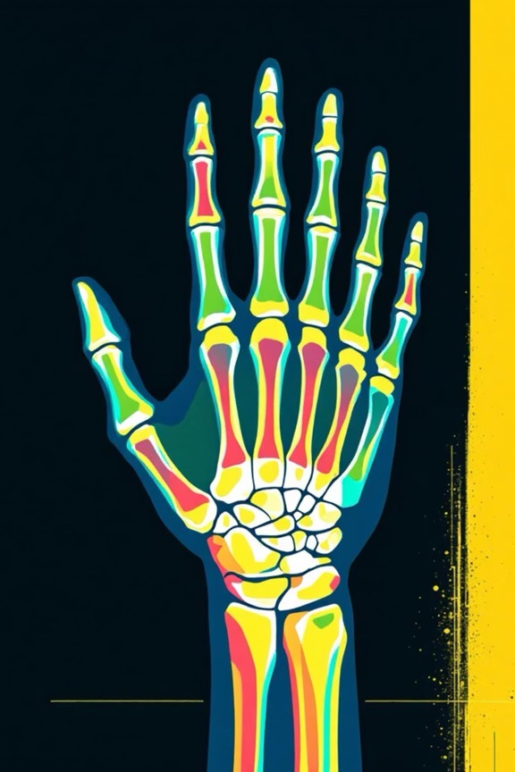
Bone Age Predictions from
Hand Radiographs
Pattern Recognition and Machine Learning Course Project
Authors :
Sanshrey (cs23b2014)
Varshith (cs23b2015)
Lohith (cs23b2030)

Slide 2

Problem Statement &
Objectives
Regression Task
Predicts bone age from a hand X-ray . This involves mapping
f : Image —> Age (in years)
Classification Task
Develop a model to classify bone age into distinct stages
Eg : Child , Adolescent , Adult
Bone age reflects skeletal maturity and is widely used in pediatrics to assess growth disorders and endocrine abnormalities.

Slide 3
Dataset — RSNA Bone age Dataset
The Dataset contains 12,611 training images
The ages are ranging from 1 to 228 months (0.08-19 years)
General Structure of CSV File
Split of the Dataset
Train (70%) - 8,827 Validation(15%)-1,892 Test(15%) - 1,892
Column name | Description | Example Value
Id | Unique image identifier | 12345
bone_age | Age in months | 156
Sex | Biological sex | F

Slide 4
Preprocessing & Data Augmentation
To ensure robust model performance , images underwent rigours preprocessing and augmentation
Image Resizing - All images were uniformly resized to 384x384 pixels
2) Channel Conversion - Grayscale X-rays are converted to 3-channel RGB fformat
3) Normalization -All images were normalized using imageNet mean & std
4) Augmentation -Techniques include rotation, zoom, brightness, contrast adjustments , and horizontal flipping

Slide 5
Regression Model Architecture
EfficientNet-B0 Backbone (Feature Extractor)
Input : 384 x 384 x 3 RGB Hand X-Ray Image
Pre-Trained on ImageNet
Output Features : 1280 -Dimensional Vector (via Global Average Pooling)
Sex-Aware Head (Image features + sex to predict bone_age)
Sex Embedding : 2(M/F) —> 32 Dimensions
Feature Concatenation : 1280 + 32 =1,312 Features
Fully Connected Layers :
Dense (256) —> ReLU —> Dropout(0.3)
Dens (128) —> ReLU —> Dropout(0.2)
Dense(1) —> Predicted Bone Age

Slide 6
Output
Final Output : Bone Age (in Years)
Loss Function : Huber Loss
Training Epochs : 50
Justifications
EfficientNet-B0 : High accuracy with only 4.4M parameters
Sex Embedding : Captures Biological growth differences
Huber Loss : Robust to Outliers compared to MSE
Dropout : Increases Generalization and prevents overfitting on medical images

Slide 7
XGBOOST Ensembles Model
Features taken from the trained
CNN regression model
Model : XGBoost Regressor
Input : 1312-Dim extracted CNN features
Weighted Ensemble
Final Prediction = 0.7 X CNN + 0.3 X XGBoost
Purpose :
To Combine deep leaning features
With traditional boosting
Improves regression accuracy
And generalisation

Slide 8
Classification Model Architecture
EfficientNet-B0 Backbone (Feature Extractor)
Input : 384 x 384 x 3 RGB Hand X-Ray Image
Pre-Trained on ImageNet
Output Features : 1280 -Dimensional Vector (via Global Average Pooling)
Sex-Aware Head (Image features + sex to predict bone_age)
Sex Embedding : 2 —> 32 Dimensions
Feature Concatenation : 1280 + 32 =1,312 Features
Fully Connected Layers :
Dense (256) —> ReLU —> Dropout(0.3)
Dens (128) —> ReLU —> Dropout(0.2)

Slide 9
Output Layer
Dense (4) + Softmax Activation
Predicted Classes :
Infant / Toddler
Child
Pre-Adolescent
Adolescent
Training Setup :
Loss Function : Categorical Cross Entropy
Optimizer : AdamW
Justification
Shared Backbone Improves generalisation
Sex embedding improves class boundary learning
Softmax enables probabilistic class predictions

Slide 10
Training Configuration
Hardware Setup
System : Apple MAC M4
Memory : 16 GB RAM
Acceleration : MPS
Optimization & Hyper parameters
Optimizer : AdamW
Learning Rate : 1 X 10^-4
Learning Rate Scheduler : Cosine Anneling
with Warmup
Batch size : 16 (Memory optimized )
Training Settings
Epochs:
Regression : 50
Classification : 40
Early stopping :
Patience : 10
Min_delta : 0.001

Slide 11
Regression Perfomance
Metric | Value
MAE (Years) | 0.6154
MAE (Months) | 7.38
RMSE (Years) | 0.8126
RMSE (Months) | 9.75
R^2 | 0.9431
Samples | 1,829
The Regression model achieves an MAE of 7.38 months on the holdout test set , which lies within acceptable clinical tolerance
A high R^2 score of 0.9431 indicates that the model explains 94.31% of the variance in bone age
The Close match between validation and test error confirms the model’s strong generalization and consistency

Slide 12
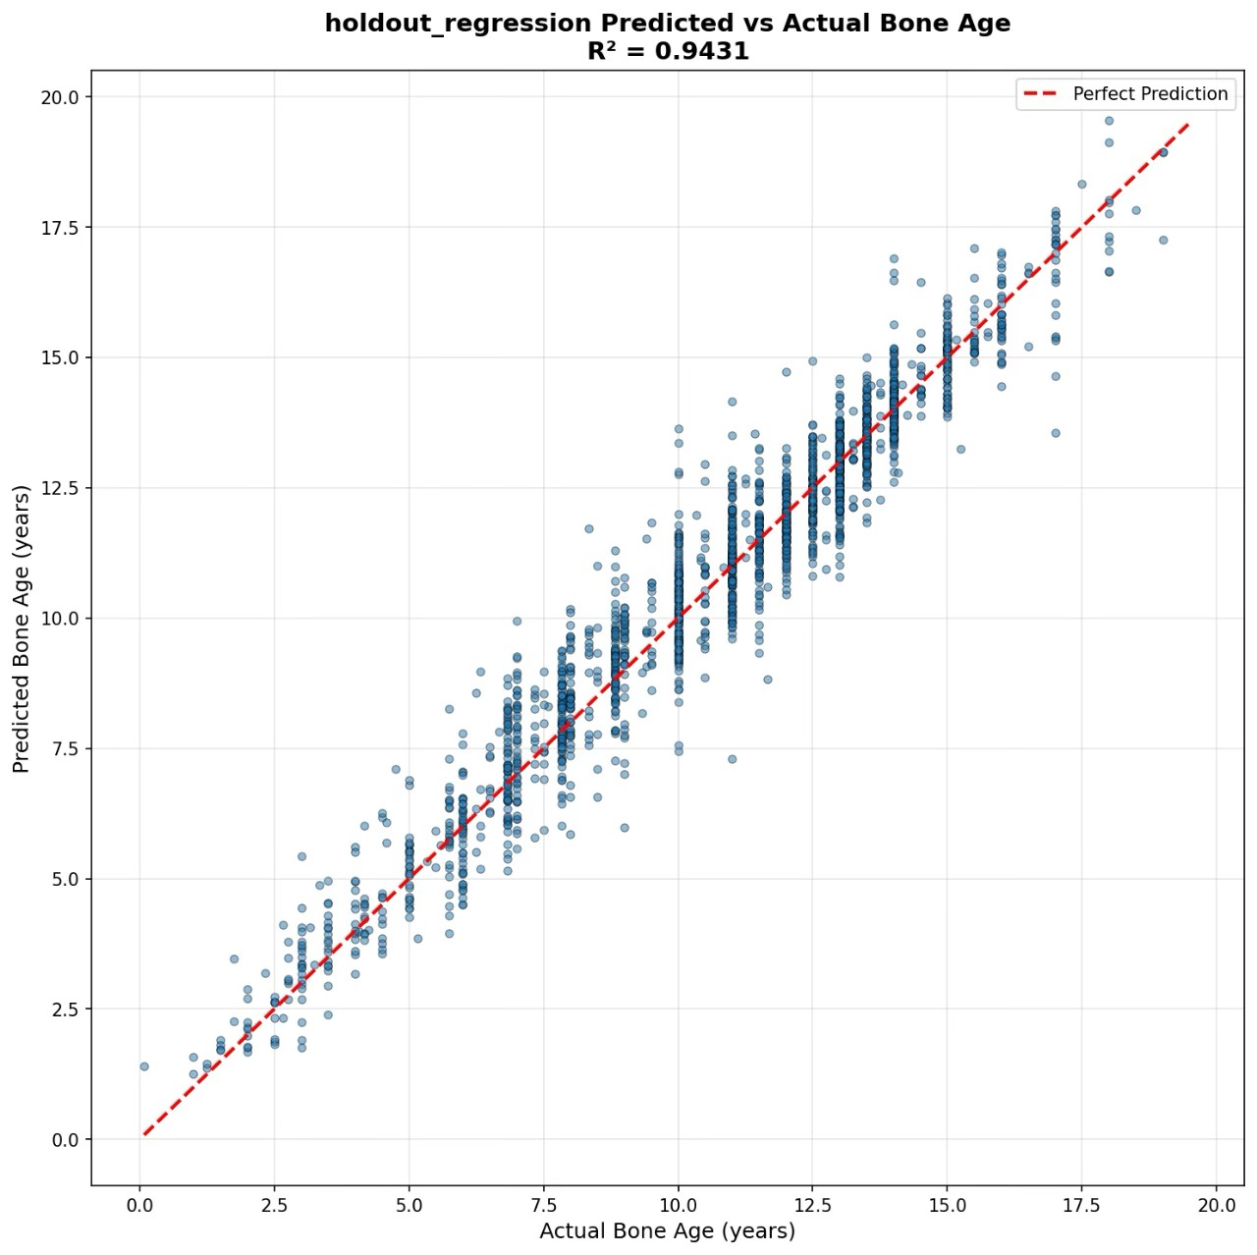
Predicted vs Actual Regression Plot
The Scatter plot shows a strong alignment between predicted and actual bone ages , closely following the perfect prediction line
The High R^2 value of 0.9413 confirms excellent regression accuracy and generalization

Slide 13
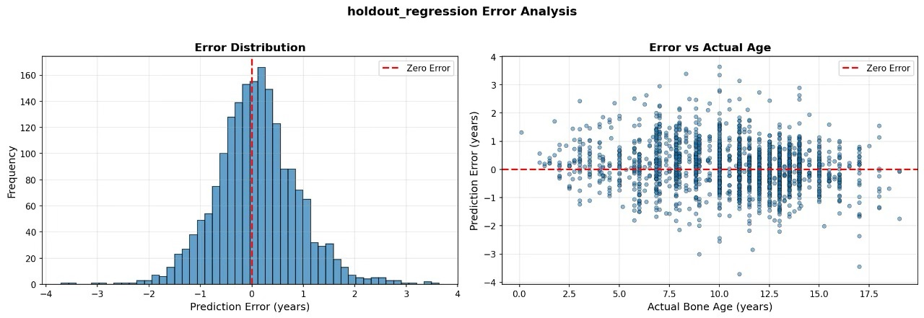
Regression Error Analysis
The error distribution is centered near zero and approximately Gaussian , indicating unbiased and stable predictions
The error vs age plot shows no strong trend

Slide 14
Classification Metrics
Metric | Value
Accuracy | 88.90%
Precision | 0.8924
Recall | 0.8890
F1 - Score | 0.8894
Quadratic Weighted Kappa | 0.8950
This high QWK score indicates excellent agreement with ground truth , accounting for ordinal nature of age categories

Slide 15
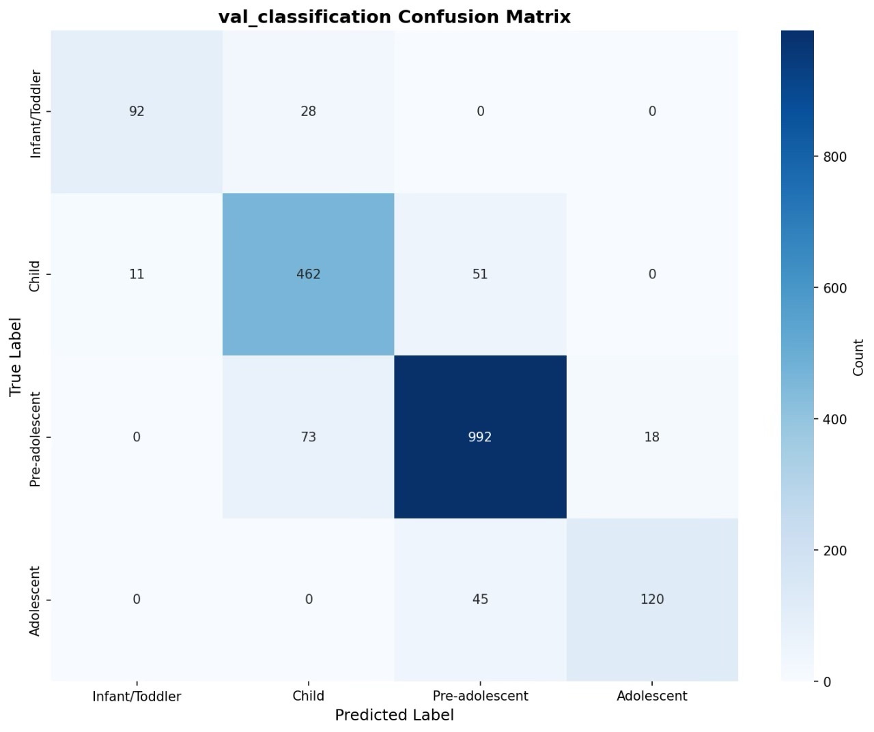
Confusion Matrix
The matrix shows strong diagonal dominance , indicating high classification accuracy across all ages groups
Most errors occur between adjacent stages (Child <—> Pre-Adolescent ) , which is expected due to their overlapping developmental boundaries

Slide 16
Individual Model Comparison
Model | MAE | RMSE | R^2
CNN Only | 7.35 | 9.66 | 0.9444
XGBoost | 7.89 | 10.12 | 0.9298
Ensemble(0.7+0.3) | 7.15 | 9.43 | 0.9467
Improvement : Ensemble Combines CNN’s feature learning with XGBoost’s tree-based refinement

Slide 17
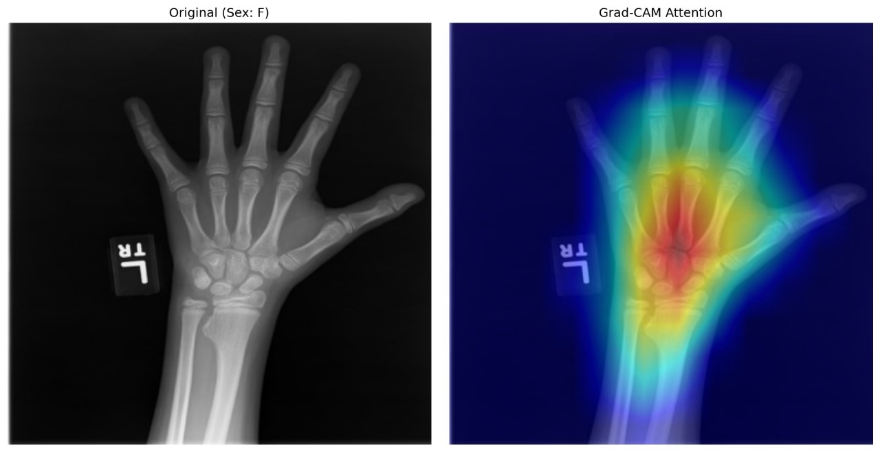
Model Interpretability (Grad-cam)
The heat map shows that the model focuses on clinically important regions such as the carpal bones and growth plates
This confirms that the network has learned medically meaningful features for bone age prediction , not background artifacts

Slide 18
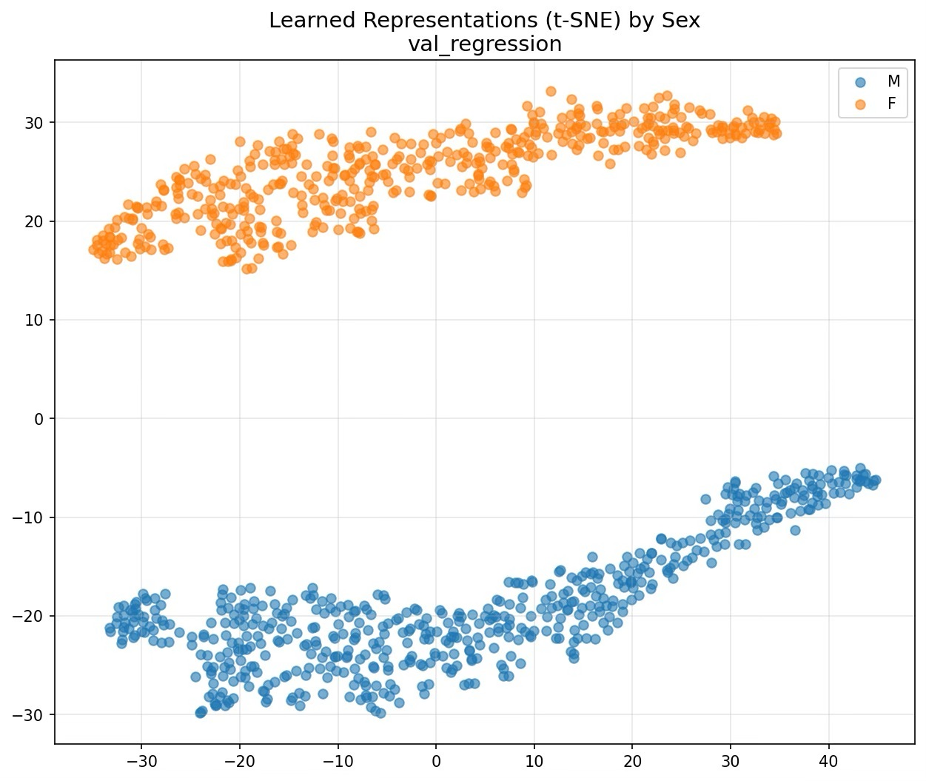
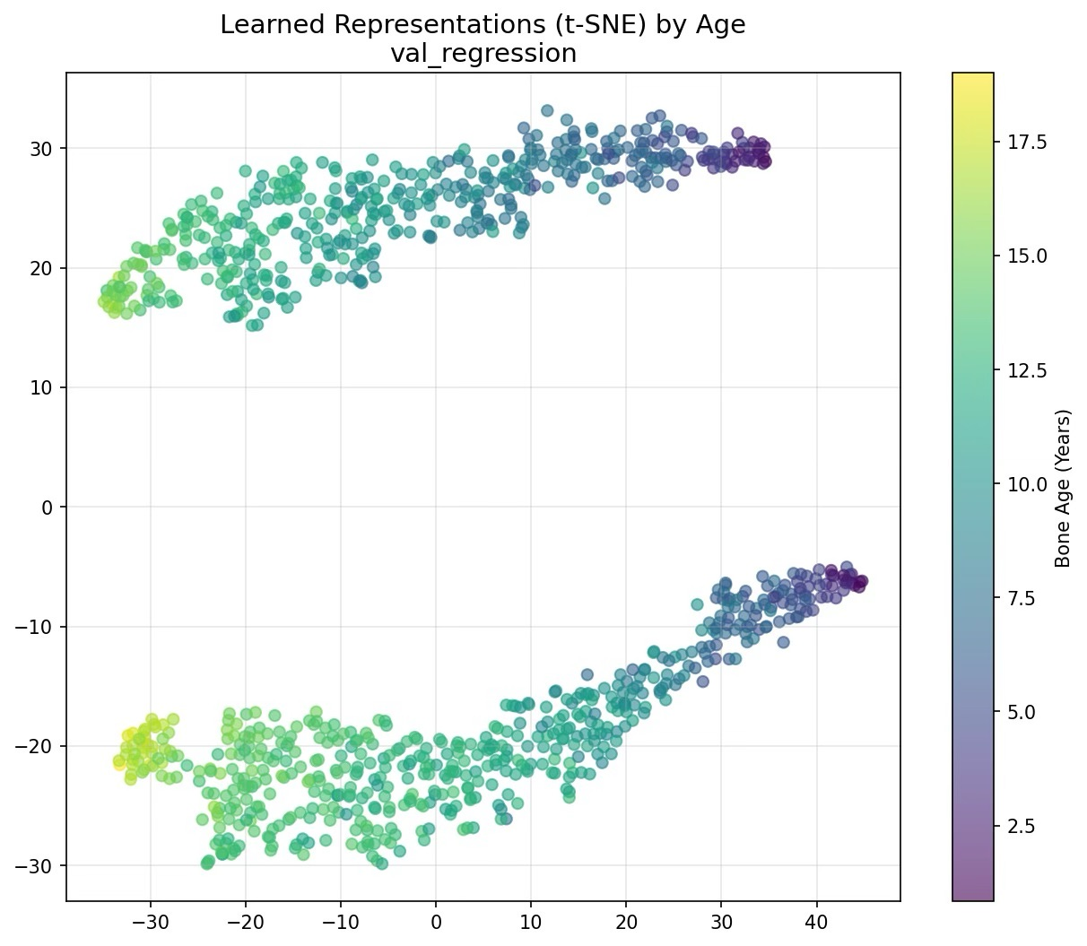
t-SNE Feature Visualizations

Slide 19
t-SNE is a dimensionality reduction technique that converts high dimensional deep learning features into 2D for Visualisation , allowing us to observe how the model organises data by age and sex
The t-SNE visualization shows clear separation between male and female feature representations, confirming that the model captures sex-specific growth patterns.
The age-colored t-SNE plot shows a smooth progression from younger to older bone ages, indicating that the network has learned a continuous skeletal maturity representation.

Slide 20
Conclusion
We successfully developed a deep learning–based system for automated bone age prediction and stage-wise classification from hand X-ray images.
The regression model achieved expert-level accuracy with an MAE of 7.38 months and R² = 0.9431, while the classification model attained 88.9% accuracy.
Grad-CAM and t-SNE analysis confirmed that the model learns clinically meaningful and biologically consistent features.
The proposed system can serve as an effective clinical decision-support tool, reducing radiologist workload and enabling faster pediatric assessments.

Slide 21
Thank You

